Slide 1
2-Layer GNNs with Hypernetworks
Gal Kampel 304827702 Sagi Kuperstein 201271509

Slide 2
Graph Neural Networks (GNN)
CNNs have been successfully applied to tackle problems where the underlying data representation has a grid-like structure.
Many tasks involve data that cannot be represented in a grid-like structure and that instead lies in an irregular domain.
There are irregular domains that can be represented in the form of graphs- social networks, biological networks, citation networks and more.
Graph neural networks (GNN) are models that try to generalize the notion of the convolution operation to an operation that operates on an arbitrary graph domain.
An iterative process of nodes' updates, until equilibrium is reached, which are then applied to an invariant to permutation function to get the final prediction.
A good embedded representation of a node, is a representation that takes into account both node’s (initial) features and the topology of the graph.

Slide 3
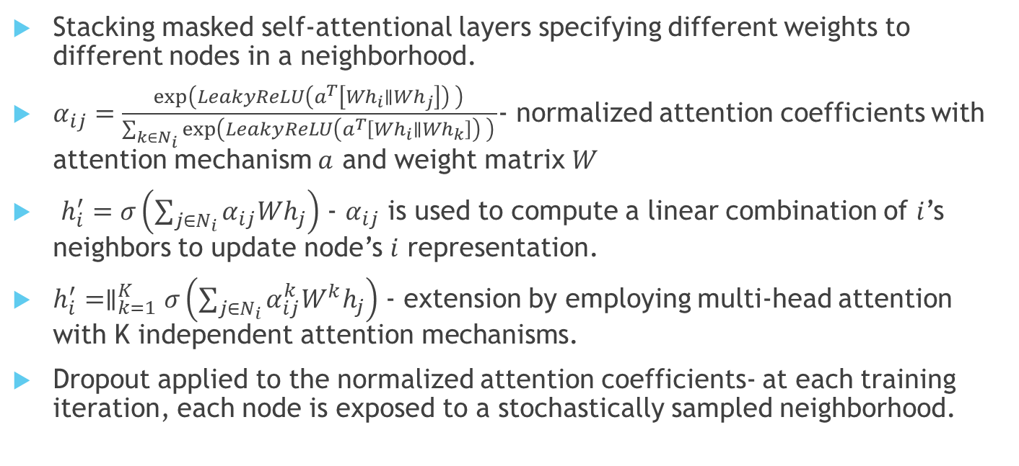
Graph Attentional Network (GAT)
Stacking masked self-attentional layers specifying different weights to different nodes in a neighborhood.
$α_{ij}=\frac{\exp\left(LeakyReLU\left(a^{T}\left[Wh_{i}∥Wh_{j}\right]\right) \right) }{\sum_{k∈N_{i}}{\exp\left(LeakyReLU\left(a^{T}\left[Wh_{i}∥Wh_{k}\right]\right) \right) }}$- normalized attention coefficients with attention mechanism $a$ and weight matrix $W$
$h_{i}^{′}=σ\left(\sum_{j∈N_{i}}{α_{ij}Wh_{j}}\right)$ - $α_{ij}$ is used to compute a linear combination of $i$’s neighbors to update node’s $i$ representation.
$h_{i}^{′}=∥_{k=1}^{K}σ\left(\sum_{j∈N_{i}}{α_{ij}^{k}W^{k}h_{j}}\right)$ - extension by employing multi-head attention with K independent attention mechanisms.
Dropout applied to the normalized attention coefficients- at each training iteration, each node is exposed to a stochastically sampled neighborhood.
Notes:
Masked- the attention is over the (first-order) neighborhood of $i$ (including $i$ itself)
$σ$ is the ELU nonlinearity function

Slide 4
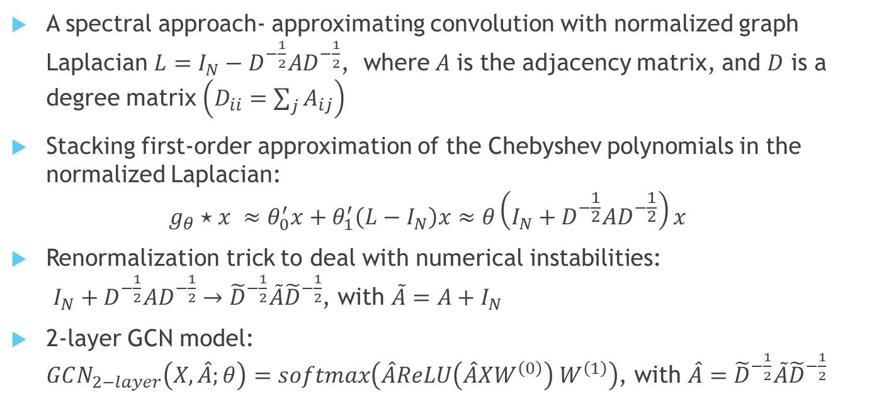
Graph Convolution Network (GCN)
A spectral approach- approximating convolution with normalized graph Laplacian $L=I_{N}−D^{−\frac{1}{2}}AD^{−\frac{1}{2}}$, where$A$ is the adjacency matrix, and $D$ is a degree matrix $\left(D_{ii}=\sum_{j}{A_{ij}}\right)$
Stacking first-order approximation of the Chebyshev polynomials in the normalized Laplacian: $g_{θ}⋆x ≈θ_{0}^{′}x+θ_{1}^{′}\left(L−I_{N}\right)x≈θ\left(I_{N}+D^{−\frac{1}{2}}AD^{−\frac{1}{2}}\right)x$
Renormalization trick to deal with numerical instabilities: $I_{N}+D^{−\frac{1}{2}}AD^{−\frac{1}{2}}→{\tilde{D}}^{−\frac{1}{2}}\tilde{A}{\tilde{D}}^{−\frac{1}{2}}$, with $\tilde{A}=A+I_{N}$
2-layer GCN model: $GCN_{2−layer}\left(X, \hat{A};θ\right)=softmax\left(\hat{A}ReLU\left(\hat{A}XW^{\left(0\right)}\right) W^{\left(1\right)}\right)$, with $\hat{A}={\tilde{D}}^{−\frac{1}{2}}\tilde{A}{\tilde{D}}^{−\frac{1}{2}}$
Notes:
Spectral approach (uses the graph Laplacian)
Complexity O(|E|),
$\tilde{A}$- adjacency matrix with self loops
Depends on specific graph Laplacian (cannot be generalized to different graphs).
Need to store all the graph (computationally intensive)

Slide 5
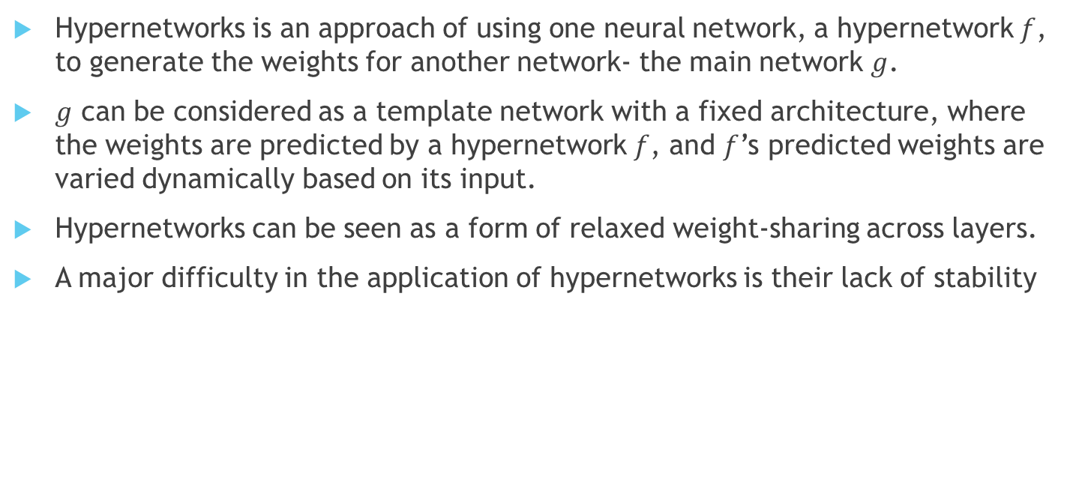
Hypernetworks
Hypernetworks is an approach of using one neural network, a hypernetwork $f$, to generate the weights for another network- the main network $g$.
$g$ can be considered as a template network with a fixed architecture, where the weights are predicted by a hypernetwork $f$, and $f$’s predicted weights are varied dynamically based on its input.
Hypernetworks can be seen as a form of relaxed weight-sharing across layers.
A major difficulty in the application of hypernetworks is their lack of stability

Slide 6
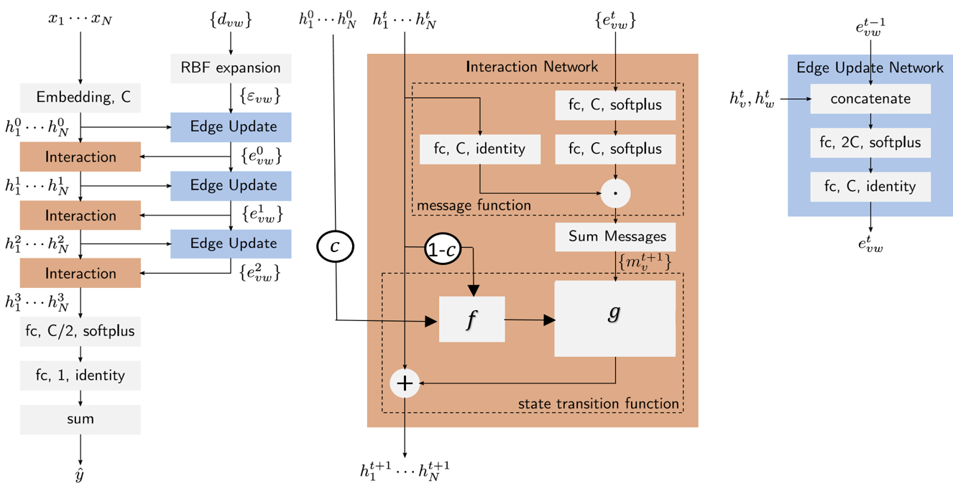
NMP-Edge with Hypernetworks
Notes:
Dealing with training instability of hypernetworks, by passing a linear combination of the current message and the first message.
We tried to use the same extension as in previous slide (with GAT), with increased depth, however it didn’t improve results (with and without hypernetworks),
mainly due to small training size.

Slide 7
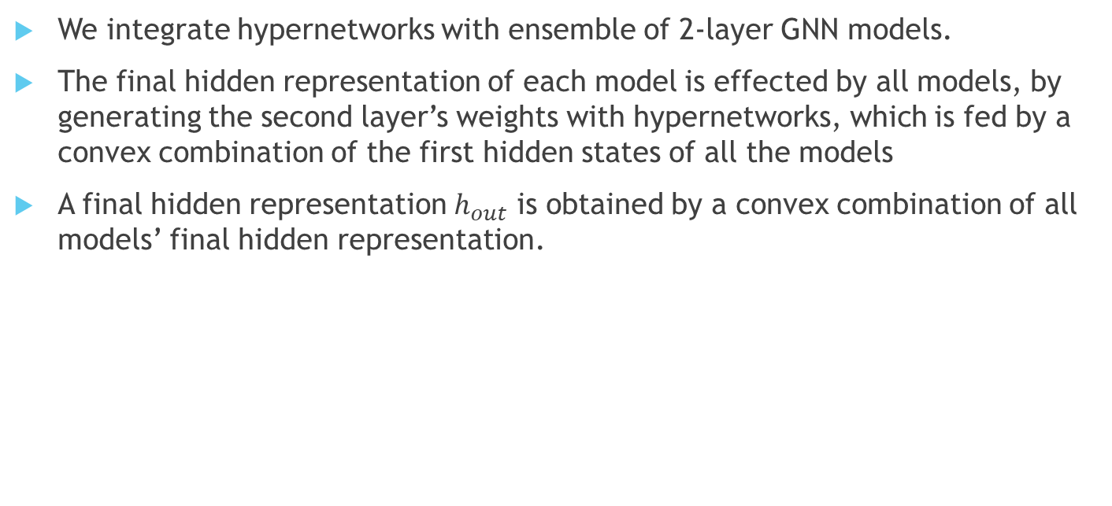
2-Layer GNNs with Hypernetworks
We integrate hypernetworks with ensemble of 2-layer GNN models.
The final hidden representation of each model is effected by all models, by generating the second layer’s weights with hypernetworks, which is fed by a convex combination of the first hidden states of all the models
A final hidden representation $h_{out}$ is obtained by a convex combination of all models’ final hidden representation.
Notes:
Instead of going “deep”, we decided to go “breadth”.

Slide 8
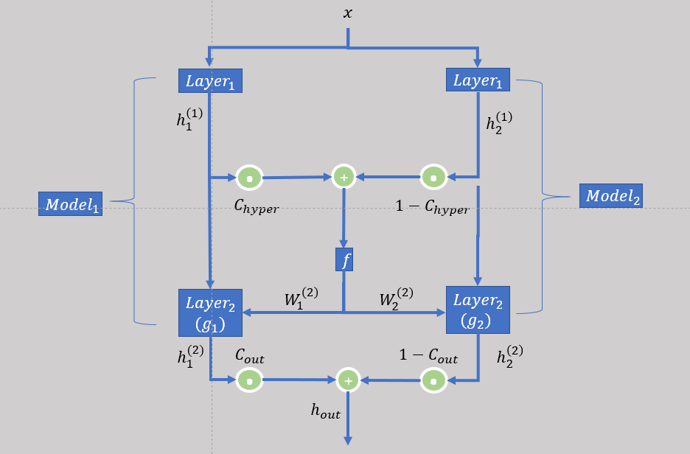
2-Layer GNNs with Hypernetworks-Architecture
Notes:
$f$ is a MLP with one hidden layer followed by tanh nonlinearity activation function
The framework can be extended easily to more than two models.

Slide 9
Pubmed Diabetes Dataset
The Pubmed Diabetes dataset is a citation network which consists of 19,717 nodes and 44,338 links, where a scientific publication corresponds to a node and a citation corresponds to an undirected link.
Each paper is represented by a sparse feature vector of TF-IDFs from a predefined dictionary, which consists of 500 unique words.
A class label indicates the type of diabetes that the publication is about- Diabetes Mellitus Experimental, Diabetes Mellitus Type 1, Diabetes Mellitus Type 2.
Semi-supervised settings:
20 nodes per class are used for training (a total of 60 nodes), when the training algorithm has access to all of the nodes’ feature vectors.
500 nodes are used for validation purposes and 1000 nodes for test.
Notes:
a vector of term frequency-inversedocument frequency (TF-IDF) of the corresponding word from a predefined dictionary,
which consists of 500 unique words, resulting a sparse bag-of-words feature vector of size500
3 class labels- DiabetesMellitus Experimental, Diabetes Mellitus Type 1, Diabetes Mellitus Type 2.
In GAT paper, GAT and GCN-64 were the best models across citation networks with semi-supervised learning (including Pubmed)

Slide 10
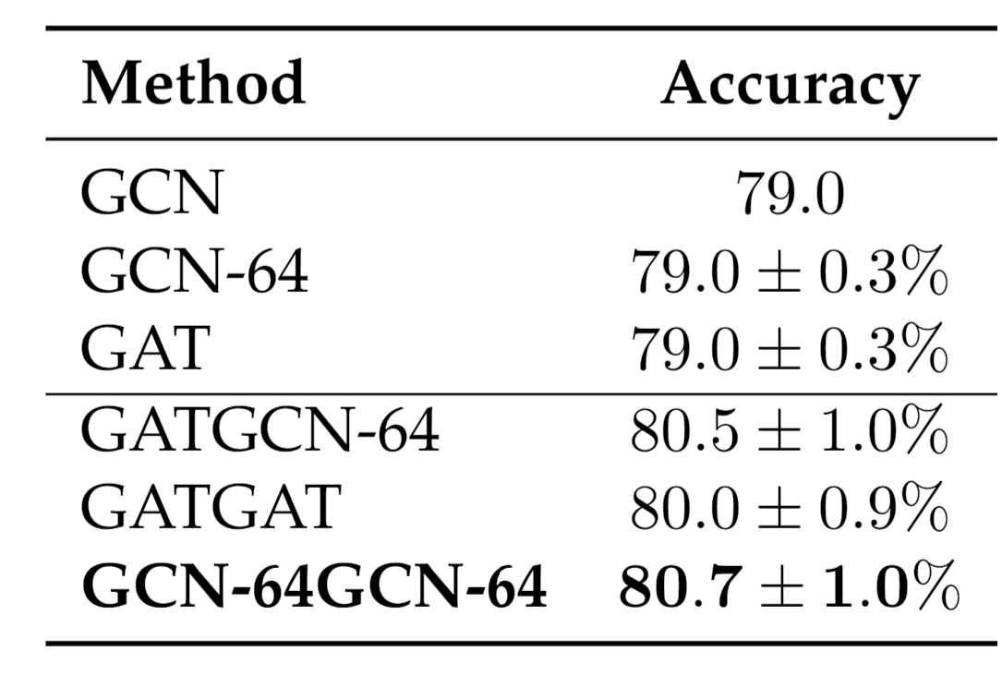
Results
Results in terms of classification accuracies for Pubmed, averaged after 10 runs.
Notes:
We denote a 2-layer GNN model instance with model1=GAT and model2=GCN-64 as GATGCN-64
GCN-64 – the hidden layer is of size 64 (64 neurons), the same as in GAT
A 2-layer GAT and a 2-layer GCN-64- are the models that achieved the best accuracy according the GAT paper for citation networks (including Pubmed).
All instances improve results
GCN-64GCN-64 is the best model

Slide 11
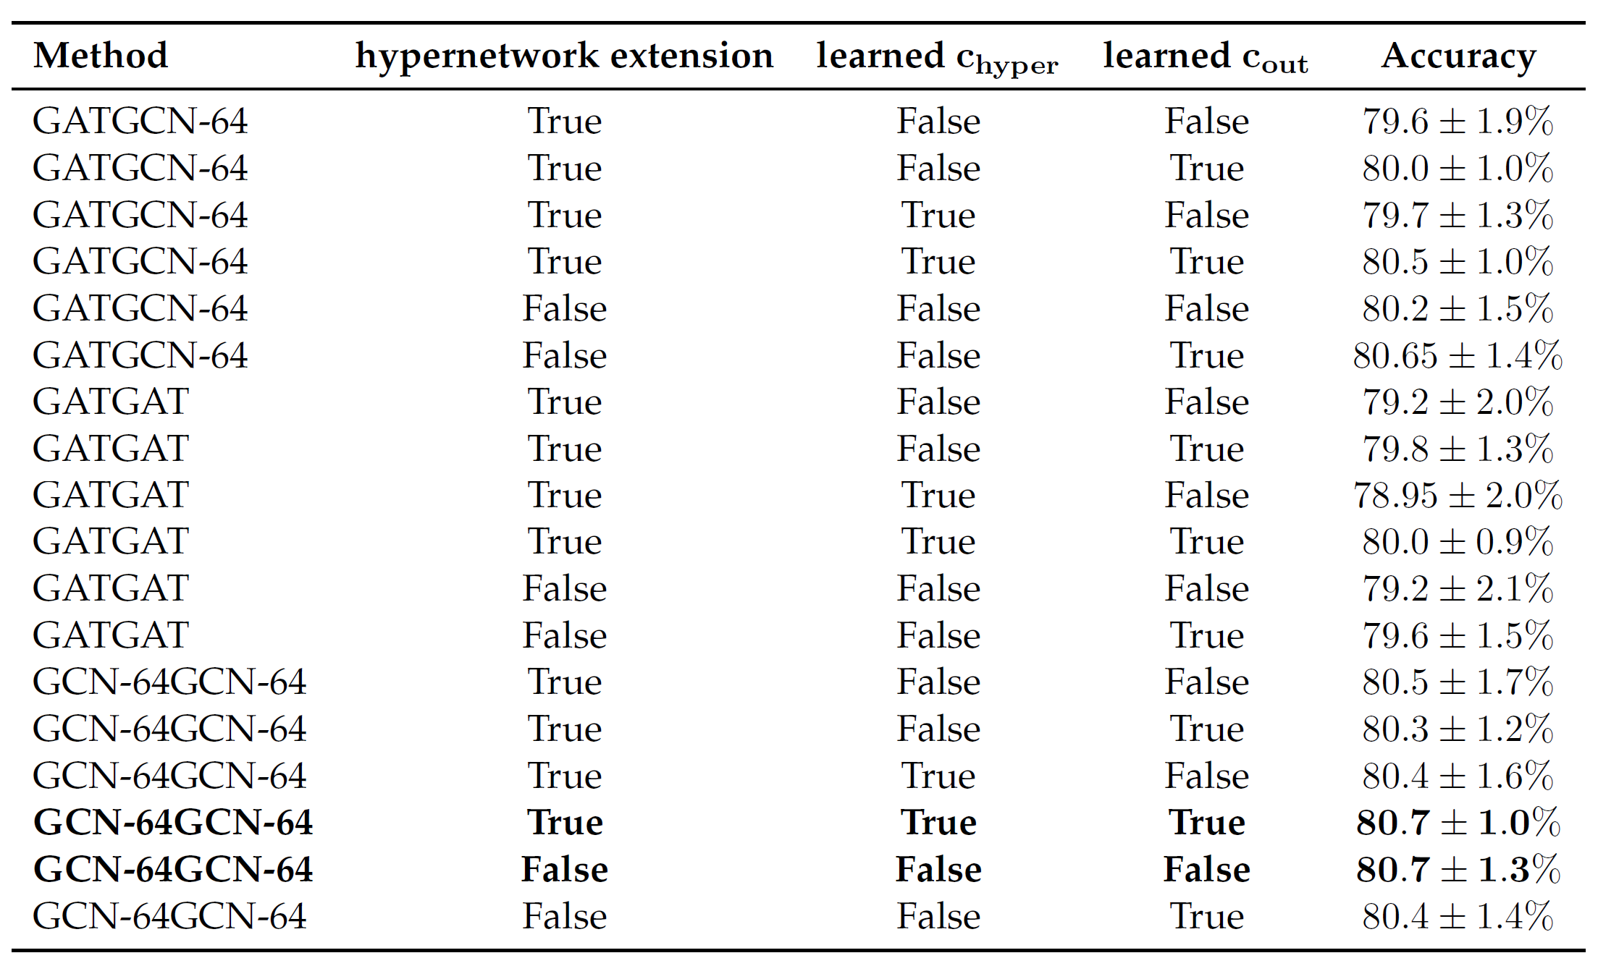
Ablation Study
Notes:
$c_{hyper}$ and $c_{out}$ are set to 0.5 (uniform) if are fixed.
GCN-64 dominated over GAT in GATGCN-64 model
When $c_{hyper}/c_{out}$ were learned, one model dominated over the other until eventually
GATGAT has a significant impact by the hypernetworks extension
Hypernetwork extension = False -> no hypernetworks (just weighted/simple average across models)

